Slide 1
Are You My Mommy?
Farm Animals and their Babies

Slide 2
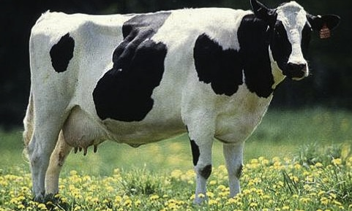
Mommy: Cow

Slide 3
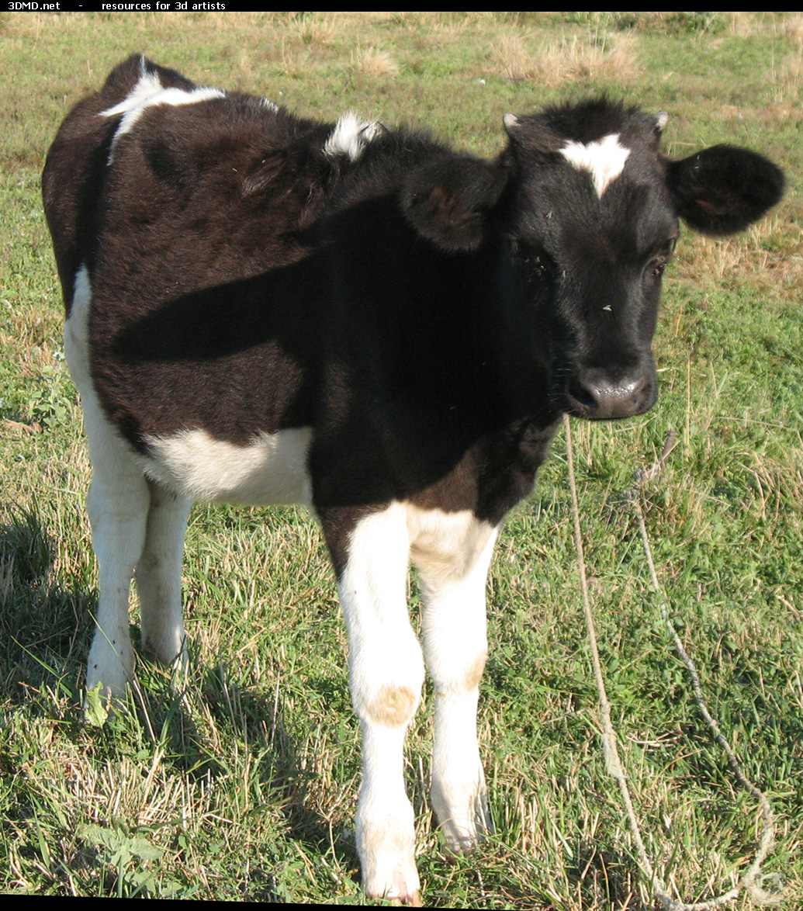
Baby: Calf

Slide 4
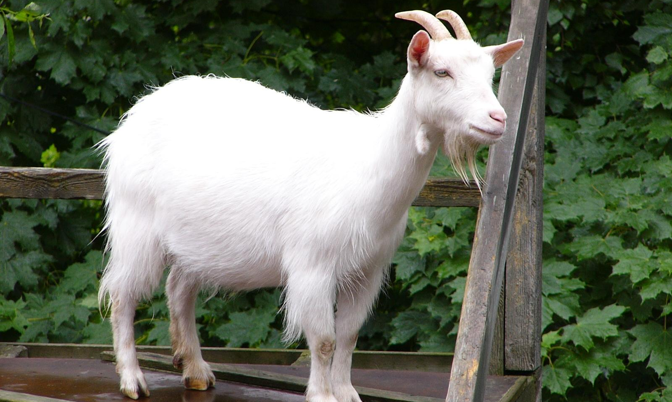
Mommy: Goat

Slide 5
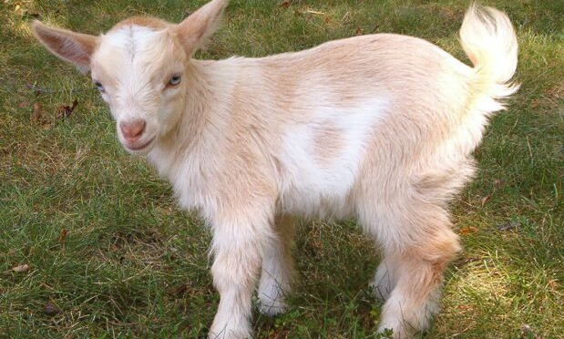
Baby: Kid

Slide 6
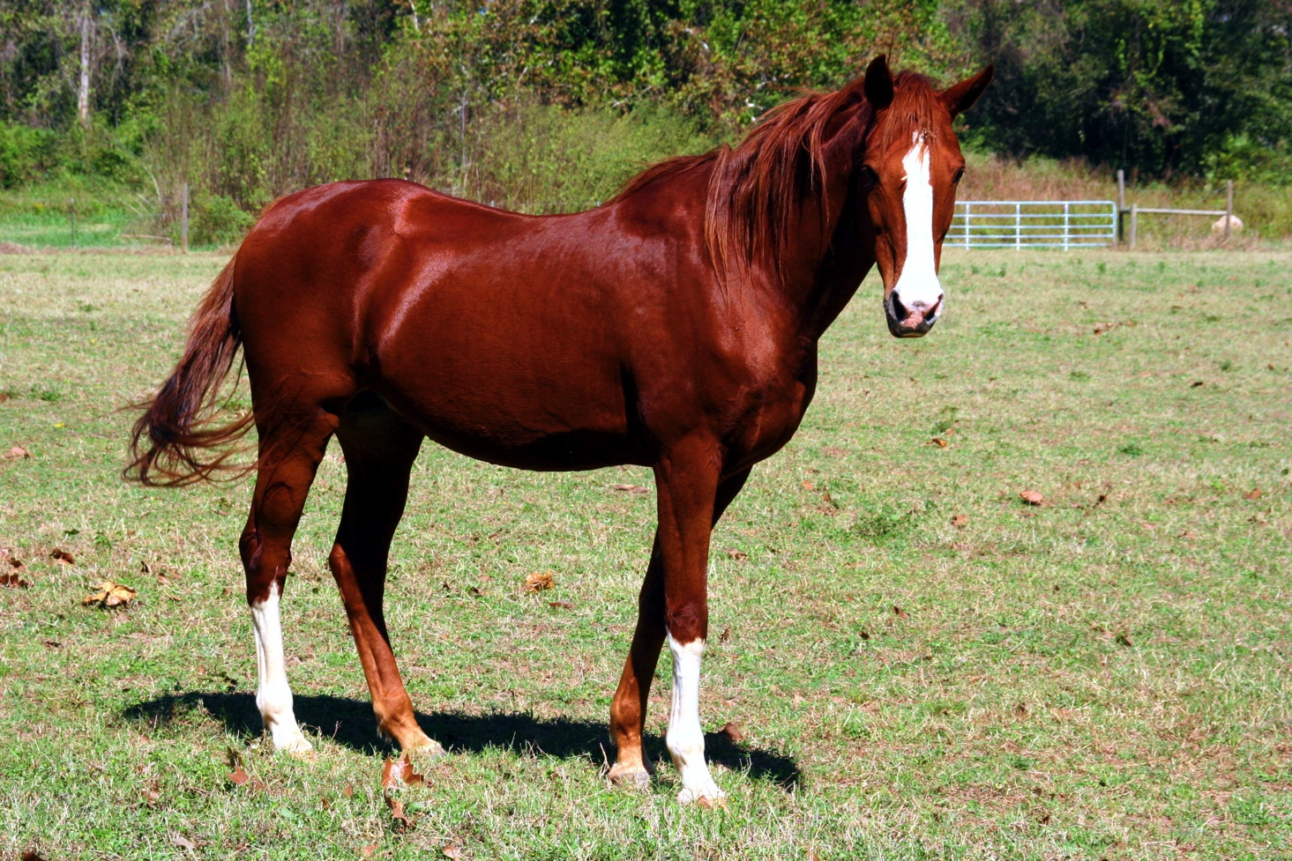
Mommy: Horse

Slide 7
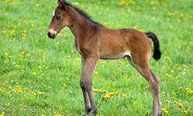
Baby: Foal

Slide 8
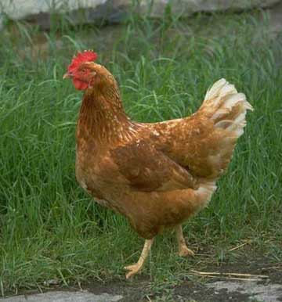
Mommy: Hen

Slide 9
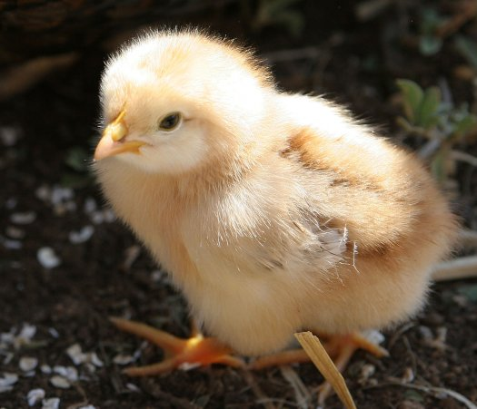
Baby: Chick

Slide 10
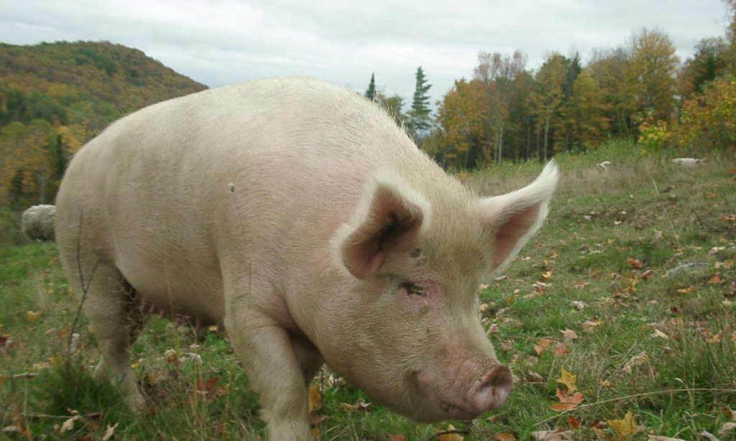
Mommy: Pig

Slide 11
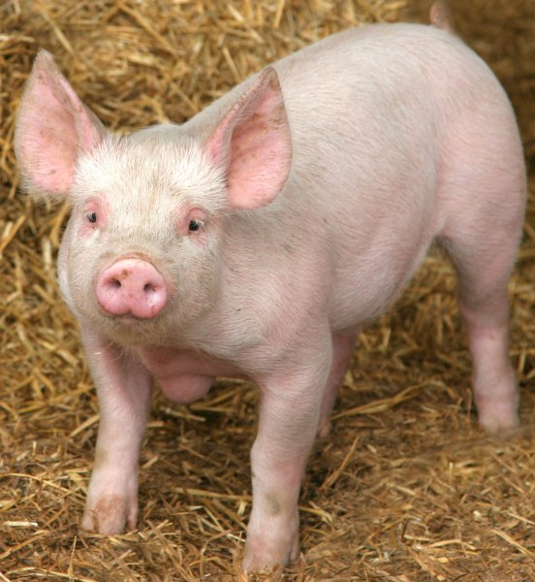
Baby: Piglet

Slide 12
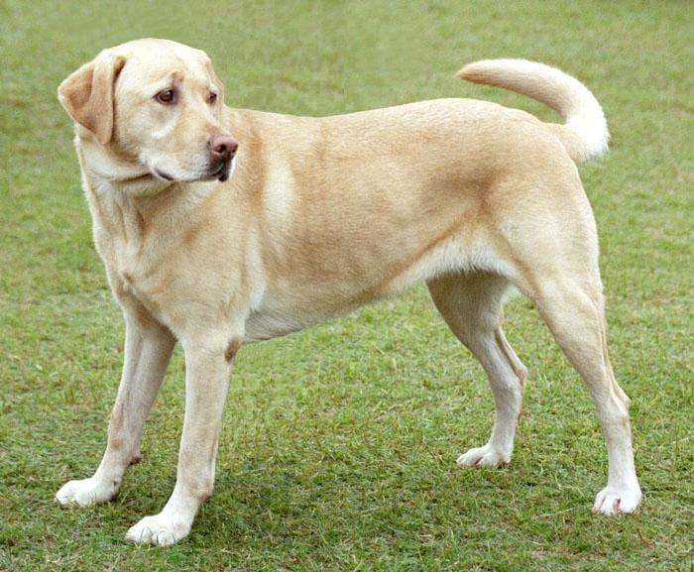
Mommy: Dog

Slide 13
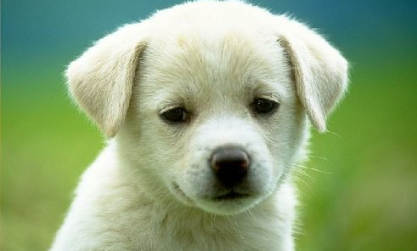
Baby: Puppy

Slide 14
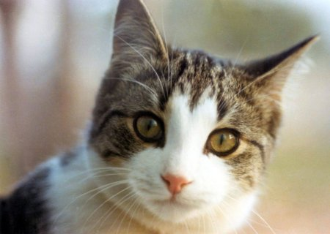
Mommy: Cat

Slide 15
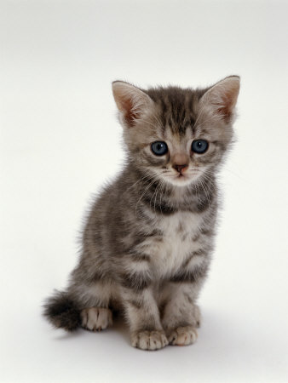
Baby: Kitten

Slide 16
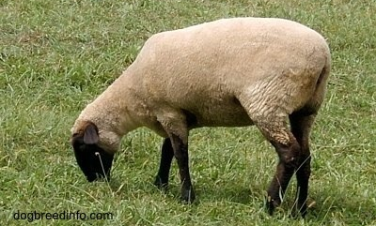
Mommy: Sheep

Slide 17
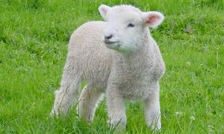
Baby: Lamb

